Slide 1
IDENTITY
THEFT
Notes:
INTRODUCTION TITLE SLIDE
NEXT SLIDE

Slide 2
GREENPATH SERVICES
$
FINANCIAL ASSESSMENTS
HOUSING COUNSELING
CREDIT REPORT COUNSELING
DEBT MANAGEMENT
Notes:
GreenPath is a non-profit organization that has been in business since 1961. GreenPath provides financial assessments based on your goals and needs, HUD-approved housing counseling, credit report reviews, and debt management services.

Slide 3
1
What is ID Theft?
3
How do thieves use your information?
5
What if you’re a victim?
2
How does ID Theft Occur?
4
How do you protect yourself?
Notes:
The issue of identity theft has become so prevalent in recent years that the U.S. government has made identity theft a federal crime, punishable by imprisonment of up to two years for general identity theft crimes and up to five years for terrorism-based identity theft crimes.
Today, we’ll cover what identity theft is, including how it occurs, how thieves use your information, how to protect yourself, and what to do if you become a victim.

Slide 4
1
What is ID Theft?
3
How do thieves use your information?
5
What if you’re a victim?
2
How does ID Theft Occur?
4
How do you protect yourself?
6
FAQ’s
Notes:
Let’s start with the basics- what is ID Theft?

Slide 5
What is ID theft?
The crime of using another person’s personal information, credit history or other identifying characteristics in order to make purchases or borrow money without that person’s permission.
?
Notes:
More than 14 million people were victims of identity theft in 2018, according to Javelin Strategy & Research.
Identity Theft is: the crime of using another person’s personal information, credit history or other identifying characteristics in order to make purchases or borrow money without that person’s permission.
It is easy to assume that it will never happen to us, but the truth is 19 people become the victims of ID theft each minute. Victims include everyone - children, teens, adults
Identity theft is scary but we are going to help. Today we’ll arm you with tools to fend off identity theft as well as resources and steps to take if you do fall victim.
CLICK TO NEXT SLIDE.

Slide 6
Computer Crime
Personal Betrayal
Document loss
Business Leaks
Data is stolen during your online activities
A friend, relative, employee or stranger steals your data
Wallet, checkbook, credit cards, or mail is lost or stolen
Information is stolen and exploited from a place where you’ve done business
Notes:
Identity theft occurs in many different forms:
Computer crime – This occurs when data is stolen from you during your online activities.
Personal betrayal – This occurs when a friend, relative, employee or stranger steals your data.
Document Loss– This occurs when you lose your wallet, checkbook or credit cards or your mail or trash is stolen.
Business Leaks– This occurs when your personal files are stolen and exploited from a place where you have conducted business.

Slide 7
1
What is ID Theft?
3
How would thieves use your information?
5
What if you’re a victim?
2
How does ID Theft Occur?
4
How do you protect yourself?
6
FAQ’s
Notes:
Now that we know what identity theft is – how does it happen?

Slide 8
Steal wallet, mail
Dumpster dive
Rob house or business
Email scams
ATM, credit card skimming
Corporate data
breaches
Pharming
Phishing
Notes:
Steal and rob – wallet, purse, backpack, mail
Dumpster dive: to get registration cards, insurance cards, mortgage statements
Scams – you’re a winner!
Corporate data breaches – so many of these nowadays
Pharming
Phishing – let’s talk more about these last two

Slide 9
PHARMING:
A process that steals information from unsuspecting internet users
Notes:
Pharming is a process that steals information from unsuspecting internet users. It’s a cyber attack intended to redirect a website's traffic to a different, fake site.

Slide 10
Notes:
Before entering any personal information on a website, it’s important to make sure it’s secure. How would we know?

Slide 11
Notes:
It would have the “S” and sometimes even a lock!

Slide 12
PHISHING
A practice that online fraudsters use to “fish” for confidential passwords and financial data from the “sea” of internet users using email.
Notes:
Phishing is a practice that online fraudsters use to ‘fish’ for confidential passwords and financial data from the ‘sea’ of internet users using email.

Slide 13
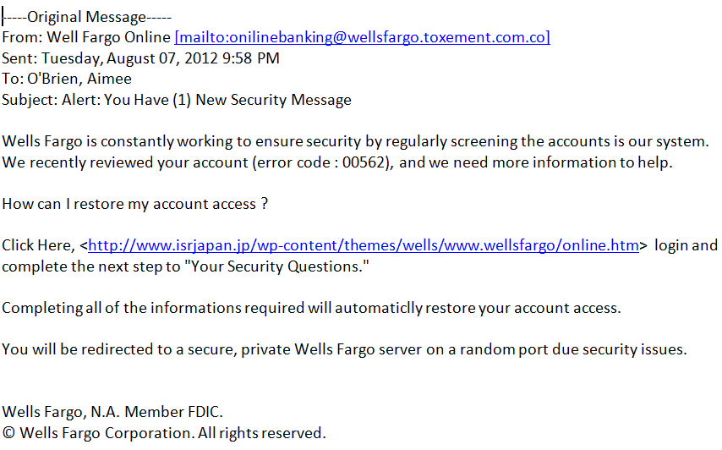
Notes:
Let’s do an exercise. Who can spot what’s wrong with this email? What are the red flags you’d notice that would identify to you this email is not from a trustworthy source? What items should you look out for when you receive emails like this? Misspellings, typos, random web links, strange ‘from’ email address, a sense of urgency, a generic greeting. These would not appear in this way in a professional banking email from a large corporation.
How do you protect yourself? Delete these emails! Do not reply, do not click on the links, do not open attachments, do not call the phone # listed in the email.

Slide 14
1
What is ID Theft?
3
How do thieves use your information?
5
What if you’re a victim?
2
How does ID Theft Occur?
4
How do you protect yourself?
6
FAQ’s

Slide 15
BUY MERCHANDISE
OPEN NEW ACCOUNTS
How Do ID Thieves Use Your Information?
ESTABLISH SERVICES IN YOUR NAME
TAKE OUT LOANS/OPEN ACCOUNTS
OBTAIN A PASSPORT, INSURANCE OR ID
SELL YOUR INFORMATION
Notes:
Once identity thieves steal your identity, some things they can do include:
Applying for credit cards or loans in your name.
Withdrawing funds from your accounts.
Using your health insurance to obtain medical care.
Using your Social Security number to stead your tax refund.
Sell your information on the dark web to other criminals.

Slide 16
1
What is ID Theft?
3
How do thieves use your information?
5
What if you’re a victim?
2
How does ID Theft Occur?
4
How do you protect yourself?
6
FAQ’s

Slide 17
MONITOR YOUR CREDIT REPORT
annualcreditreport.com
Central Source LLC P.O. Box 105283 Atlanta, GA 30348-5283
Phone: 877-322-8228
You can receive your credit report ONLINE or by MAIL
Notes:
The best place to get your credit report is annualcreditreport.com. It is the website that was set up as a result of the Fair Credit Reporting Act that states that you are entitled to receive a free copy of your credit report. That act also says that you have a right to see a copy of each of your three credit reports every 12 months.
There is also a form you can use if you prefer to request your credit report by mail from any, or all, of the nationwide consumer credit reporting companies. The form can be found online at annualcreditreport.com or you call 877-322-8228 to receive it.
If you anticipate the need to borrow money, however, we suggest you take a look at your credit at least 6 months prior so that if there are any errors you have time to correct them before you apply.
NEXT SLIDE

Slide 18
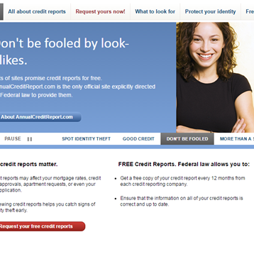
MONITOR YOUR
CREDIT REPORT
Notes:
When you go to annualcreditreport.com your screen should look similar to this one.
Please note that only the reports are free. If you wish to obtain your scores, you’ll still pay– usually about $6 to $8 per credit bureaus.
There was a recent law put into effect that requires a lender to provide the credit score they used if they make an “adverse” decision to your application for credit. This includes being denied for a loan/credit card or getting approved at an interest rate higher than the best rate being offered. We don’t recommend applying for something knowing you’ll be denied just to get your free credit score– doing so can actually hurt your score.
When you go on the annualcreditreport site, you’ll be asked several security questions. There may even be trick questions. For example, it might say that you opened a mortgage in May, 2008 and ask the name of the lender. If you have never taken out a mortgage, the answer might be N/A (not applicable). Keep in mind that these questions are meant to ensure you are who you say you are.
You have the option of getting all three reports at the same time. If you have never seen your reports, this may be a great idea. However, another option is to stagger the reports, where you would get a different report every four months. For example, I could get Experian in May, Equifax in September and Transunion in January. I’d then be eligible to get Experian again in May of the following year. Doing this allows you to view your report 3 times a year instead of just once and may alert you to any fraud or ID theft faster.
NEXT SLIDE

Slide 19
USE STRONG PASSWORDS
Mix it up – different for each account
On your phone and computer too
Use a passphrase instead of a password
NowIsTheTimeForPumpkins1999
Notes:
Another big way to protect yourself is to use strong passwords. Here are some good rules of thumb.
Use different passwords for each account (try using a password manager so you don’t have to remember them all).
Don’t just protect your accounts – protect your devices too. Use passwords on your phone and computer.
Try using longer passphrases instead of passwords. They are easier to remember and more difficult to hack.

Slide 20
Be Vigilant
Steer clear of suspicious websites and links
Don’t give out your personal info to a caller, or through email
Delete unknown emails and don’t download attachments
Protect your personal documents – shred!
Limit your exposure
Notes:
More ways to protect yourself – be vigilant.
Take stock – are there ways you’re currently putting yourself at risk? Or alternately, ways that you’ve worked to protect yourself? Share with the group.

Slide 21
1
What is ID Theft?
3
How do thieves use your information?
5
What if you’re a victim?
2
How does ID Theft Occur?
4
How do you protect yourself?
6
FAQ’s

Slide 22
Unexplained charges
Not receiving bills
Receiving credit cards you didn’t order
Denied credit for no reason
How would
you know?
Inaccuracies on credit report
Collection calls
Notes:
Source: https://www.experian.com/blogs/ask-experian/how-to-protect-yourself-from-identity-theft/
How will you know that you’ve been a victim?
1. You No Longer Get Your Household Bills in the Mail
An absence of bills in the mail could mean your personal data has been compromised, and the identity thief has changed your billing address.
2. You Are Turned Down for a Loan or Credit
If you're rejected for credit, but have a history of good credit health, you might have been targeted by an identity thief. If you're approved for a loan or credit, but at higher interest rates, that's also a sign you may have been victimized by identity theft.
3. You Are Being Billed for Purchases You Didn't Buy
Invoices for purchases you don't recognize, or if you're being billed for overdue payments for credit accounts you don't own, that's a sign you've been victimized by I.D. fraud.
4. Your Financial Accounts Have Transactions That Appear Fraudulent
If your bank, credit card or other financial account show unauthorized transactions, those accounts may have been breached.
5. Your Tax Return Is Rejected
If you filed your tax returns and received a rejection notice from the Internal Revenue Service, that could indicate a return has been fraudulently filed in your name.
6. Test Charges Appear on Your Credit Card Statement
It's common practice for identity thieves to "test" that a stolen card is still active by making low-cost purchases of under $5.00. If the credit card is approved, the fraudster knows that the path is clear for larger transactions.

Slide 23
TAKE ACTION
Contact Government Authorities – identitytheft.gov
Notes:
Source: https://www.identitytheft.gov/Steps
You have the right to create an FTC Identity Theft Report. Your FTC Identity Theft Report helps prove to businesses that someone stole your identity, and makes it easier to correct problems caused by identity theft.
You can create an FTC Identity Theft Report by filing a report with the FTC.
Here’s how filing a report helps:
It acts as a declaration of your innocence.
It helps start the investigation.
A police report serves as sworn statement that you were not responsible for any crimes the thief committed using your name. If someone accuses you of a crime committed in your name, you can show them your sworn statement.
Filing an “Identity Theft Report” at IdentityTheft.gov serves a similar function, in most cases. It’s an official statement about the crime.
Important to note: The FTC recommends filing an Identity Theft Report first, and including it when you file a police report.

Slide 24
TAKE ACTION
Contact Creditors and Financial Institutions
Notes:
Source: https://www.identitytheft.gov/know-your-rights
You have the right to:
Stop creditors and debt collectors from reporting fraudulent accounts. After you give them a copy of a valid FTC Identity Theft Report, they may not report fraudulent accounts to the credit reporting companies.
Get copies of documents related to the theft of your identity, like transaction records or applications for new accounts. Write to the company that has the documents, and include a copy of your FTC Identity Theft Report. You also can tell the company to give the documents to a specific law enforcement agency.
Stop a debt collector from contacting you. In most cases, debt collectors must stop contacting you after you send them a letter telling them to stop.
Get written information from a debt collector about a debt, including the name of the creditor and the amount you supposedly owe. If a debt collector contacts you about a debt, request this information in writing.

Slide 25
TAKE ACTION
Contact the Credit Bureaus
Notes:
Source: https://www.identitytheft.gov/know-your-rights
You have the right to:
Place a one-year fraud alert on your credit report. The fraud alert tells creditors that they must take reasonable steps to verify who is applying for credit in your name. To place this alert, contact one of the three national credit bureaus. The one you contact must notify the others.
When you place a one-year fraud alert, you’re also entitled to a free copy of your credit reports. You’ll get a confirmation letter from each credit bureau with instructions for how to get your free reports.
Place a seven-year extended fraud alert on your credit report. To do this, send a copy of your FTC Identity Theft Report to each credit bureau. The extended fraud alert means potential creditors must contact you before they issue credit in your name. In your letter, be sure to give the best way for a creditor to reach you.
Each credit bureau will send you a letter confirming that they placed an extended fraud alert on your file. That letter also will include instructions about how to get free copies of your credit report.
Get credit bureaus to remove fraudulent information from your credit report. This is called blocking. You must send them a copy of your FTC Identity Theft Report, proof of your identity, and a letter stating which information is fraudulent. Then the credit bureau must tell the relevant creditor that someone stole your identity. Creditors cannot turn fraudulent debts over to debt collectors.
Dispute fraudulent or inaccurate information on your credit report. Do this by writing to the credit bureau. They must investigate your dispute and amend your report if you are right.
You have the right to place a free credit freeze on your credit report. A credit freeze, also called a security freeze, makes it less likely that an identity thief could open a new account in your name.

Slide 26
TAKE ACTION
Contact Local Authorities
Notes:
Source: https://www.lifelock.com/learn-identity-theft-resources-how-to-report-identity-theft-to-police.html
When to report identity theft to police
The FTC says it’s important to report identity theft to the police in these three cases:
You know the identity thief or you have other information that could aid a police investigation.
An identity thief used your name in an encounter with the police. For instance, this might involve a traffic stop.
A creditor, debt collector, or other affected party insists you produce a police report.
In most other cases, you can report identity theft to IdentityTheft.gov. The FTC set up the website as a one-stop shop for reporting many types of identity theft. It also helps you to set up a recovery plan.
If you decide you want to report identity theft to the police, here are steps you can take.
Go to your local police office, as well as to the police office where the fraud took place, with this information:
A copy of your FTC Identity Theft Report
A government-issued photo ID
Proof of your address, such as a mortgage statement or utilities bill
Any proof you have of the theft, such as credit card statements, IRS notices or collection notices
Tell the police someone has stolen your identity and you want to file a report. Ask them attach your FTC complaint to the report.
Ask for a copy of your police report. You will need it to give copies to creditors and credit bureaus as you take other steps to recover from identity theft.
Tips when filing a police report
With luck, filing a police report will go smoothly. You can then concentrate on taking steps to recover from identity theft.
But some police departments may not be fully prepared to take your report. For instance, officers may be preoccupied with other crimes or unfamiliar with how to handle identity theft cases.
Here are some tips that can help.
Be firm, but calm when seeking to file a police report.
Try to remain flexible. The police may send you to a website to fill out a form, instead of taking your information in person.
Contact your state attorney general’s office if the police are unable or unwilling to take your report. States may have different processes for filing a report. An attorney general’s office or website may be able to provide the details.
Be specific. When you make a police report, give detailed information about the identity theft, such as dates accounts were opened in your name or who might have committed the fraud.
Make copies of your identity theft police report and your FTC complaint. You’ll need these to resolve any disputes with companies where the identity thief used your name.
Bottom line: Reporting identity theft to the police or the FTC is a smart step to take. It could save time and money as you recover from identity theft.

Slide 27
TAKE ACTION
Maintain Good Records & Follow-up
Notes:
Make copies of your identity theft police report and your FTC complaint. You’ll need these to resolve any disputes with companies where the identity thief used your name.

Slide 28
Know your rights
Be an educated consumer
A note on other scams...
TAKE
ACTION
Notes:
REVIEW - the laws that protect consumers, with a focus on the most important aspect of each of the laws that you want the audience to take away
Tell the audience that being familiar with the laws that protect them is very important so they don’t get taken advantage of - and emphasize the importance of reading media material on new laws or changes to existing law relating to identity theft. In other words – be wise consumers.
Fair and Accurate Credit Transactions Act (FACT Act) - gives every consumer the right to obtain a free copy of their credit report from each of the three bureaus once each year
Identity Theft and Assumption Deterrence Act – makes identity theft a federal crime
Identity Theft Penalty Enhancement Act – provides greater penalties for identity thieves
Fair Credit Billing Act – gives consumers many rights when dealing with billing errors
Electronic Fund Transfer Act – applies many of the rights under the Fair Credit Billing Act to electronic fund transfer accounts
Fair Credit Reporting Act – governs Credit Reporting Agencies – the most familiar one being credit bureaus – and is designed to promote the accuracy, fairness and the privacy of information found in consumer reports
Other Scams: Be aware of the current scams that are out there –view https://www.consumer.ftc.gov/features/scam-alerts and share some recent scams to be aware of.

Slide 29
GREENPATH FINANCIAL WELLNESS
is a nationwide non-profit that provides financial education and tools for people to lead financially healthy lives.
Notes:
Provide GreenPath contact info.

