Slide 1
PSYCHOLOGY OF SPENDING
Why We Buy

Slide 2
GREENPATH SERVICES
S
FINANCIAL ASSESSMENTS
HOUSING COUNSELING
CREDIT REPORT COUNSELING
DEBT MANAGEMENT
Notes:
GreenPath provides a variety of different services including
[click]
one on one financial assessments
[click]
housing counseling
[click]
Credit report counseling
[click]
and a Debt Management program.
This class pairs well with GreenPath’s online class Redesign Financial Habits which allows you to understand how habits work, provides tools so you can understand the financial habits you have and areas for improves then Then it walks you through step by step in creating a plan to change or create some lasting financial habits.
NEXT SLIDE

Slide 3
SPENDING HABITS
?
What do you think some of the influences are to your spending?
Notes:
So as we start looking at Psychology of Spending. We’re first going to turn our attention to our spending habits. How did we become spenders or savers?
There are various factors that have contributed to our current relationship with money.
[click]
ASK: What do you think some of the influences are to your spending?
Discuss responses
Those are all really great ideas. We’re going to focus on four influences during this workshop.

Slide 4
SPENDING HABIT INFLUENCES
SOCIAL FACTORS
SELF CONCEPT
VALUES
ADVERTISING
Notes:
We’re going to take a look at
[click once]
Values
Self Concept
Social factors
Advertising
And how these factors interact to shape our spending habits.
NEXT SLIDE

Slide 5
VALUES vs ATTITUDES
Used interchangeably, but distinct.
Strongly held beliefs.
Hard to alter
Reflect current life situation
Easier to change
Notes:
To understand why we spend we must start with understanding our values and attitudes towards money.
What is the difference between values and attitudes? The two words are often used interchangeably, but are actually rather distinct ideas.
[click]
Values are strongly held beliefs that reflect our upbringing. Without examination and conscious effort, it is very difficult to alter a personal value.
[click]
Attitudes are more easily changed. They usually reflect our current life situation, our likes and dislikes; as such they are not as deeply embedded as values.
The two work together and can influence each other, but are not the same thing.
NEXT SLIDE

Slide 6
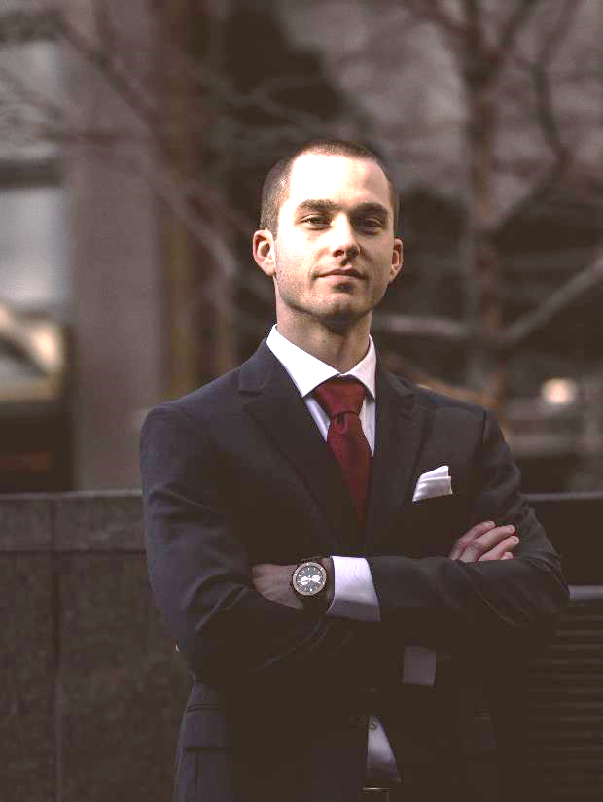
Notes:
A simple example of the difference:
Meet Robert
[click]
he values hard work and commitment
[click]
But on Monday morning at 6am, his attitude towards work may be less than positive, creating in him a negative emotional reaction to his alarm going off. His value hasn’t changed, just his immediate attitude towards going to work has. And that attitude leads to the behavior of hitting the snooze button one too many times.
NEXT SLIDE

Slide 7
VALUES
ATTITUDES
FINANCIAL GOALS
S
Where did our spending values come from?
EMOTIONAL REACTIONS
BEHAVIORS
DETOURS FROM GOALS
Notes:
That’s great… but what does that have to do with spending?
It matters because:
Our values
[click] **animation will automate**
usually influence our attitudes.
Our attitudes create an emotional reaction.
That emotional reaction can lead us to certain behaviors.
For some of us that behavior detours us from achieving our financial goals
So how do we stop the counterproductive behaviors?
We have to go back to the beginning
[click]
and understand where our values about money and spending came from.
The only way to alter your attitude toward money and thus your behavior is to understand the values that lead to those attitudes.
NEXT SLIDE

Slide 8
FAMILY
MEDIA
CULTURE
Money habits are learned
during childhood.
TV & Movies depict lifestyles that are unrealistic.
Our culture values
material goods.
Notes:
Our money values are influenced by several different factors: What affects our money values? Were going to start with our family.
[click on ‘family’ hexagon]
Family
The family in which a person is raised usually has the greatest influence on an individual’s values about money. Research finds that we are a lot more like our parents than we think, at least as far as our spending habits are concerned. Our tendency to spend or save, the way we manage money, even the brands we choose to spend our money on; are all highly influenced by what our parents did while we were growing up.
[click on hexagon 2]
Media
American movies and television shows are filled with images of “the good life.” The lifestyle depicted is often far from the reality that most of us experience; and yet, these projected images deeply influence the way we see our personal level of success and what we value.
[click on hexagon 3]
Culture
An individual’s values are also influenced by cultural values. America is a culture of spending. Since the explosion of easily accessible credit that began in the 1980s, our cultural tendency has been a “buy now, pay later” mentality. We value material goods and, culturally speaking, tend to judge others not on their character, but rather on what they own.
NEXT SLIDE

Slide 9
6
Using your experiences of happiness, certainty, success and satisfaction try to describe, in just a few words, why each experience was truly
Identify a time in your life when you made a difficult decision, but knew with all certainty that it was the
5
Once you have defined you core values, think about the ways in which you choose to
Identify a time in your life when you felt
Identify a time in your life when you felt
Identify a time in your life when you
4
EXPLORE YOUR VALUES
MOST SUCCESSFUL
PEACEFUL & SATISFIED
FELT HAPPIEST
3
Activity
SPEND MONEY
RIGHT DECISION
IMPORTANT & MEMORABLE
2
1
Notes:
Next were going to do an exercise, so if you can find a piece of paper and something to write with then you can jot down some ideas as we go along. In this exercise we will follow the next 6 steps to learn about our values.
Don’t display step 1 until all participants are prepared
[click on corresponding step to move through the activity]
**allow 2-3 minutes per step**
Step 1: Identify a time in your life when you felt the happiest
What were you doing?
Were there others with you? If so whom?
What in particular made this time happy?
Step 2: Identify a time in your life when you made a difficult decision, but knew with all certainty that it was the right decision
What made the decision difficult to make?
Did you feel relief once the decision was made?
How did you know it was the right decision?
Step 3: Identify a time in your life when you felt the most successful
What about the achievement made it a success?
Did other people know about the success or was it a personal achievement?
What particularly made you feel successful?
Step 4: Identify a time in your life when you felt the most satisfied and peaceful
What was happening at the time?
Were there others with you? If so whom?
What in particular made this time peaceful and satisfying?
Step 5: Using your experiences of happiness, certainty, success and satisfaction try to describe in just a few words why each experience was truly important and memorable.
**allow 3-5 minutes for this step after providing description below**
This exercise often leads us to our few core values
To give you some words used to describe values you can refer to the handout [NAME OF HANDOUT- list of value words]
Most people have between 3 and 7 core values. If you find you have more than 7, see if some of them group together. If so, choose the one that best represents that group of values. For instance, if you felt most successful after organizing a million dollar fund raising drive for your favorite charity you may use the value words philanthropy, community, and generosity, to describe why that event was meaningful. These three words could then be condensed even further to say that “service to others” was the true value of the event.
Step 6: Once you have defined your core values, think about the ways in which you choose to spend money.
Are your spending choices in line with your core values?
If not, what changes can you make to better align your spending and values?
**allow 3-5 minutes**

Slide 10
Your beliefs become your thoughts.
Your thoughts become your words.
Your words become your actions.
Your actions become your habits.
Your habits become your values.
Your values become your destiny.
-Gandhi
If your spending habits do not reflect your values,
make a change.
Notes:
Gandhi said: [Read the Slide]
So the question is are your current spending decisions in line with your defined values? If not, think about how you can make changes to your spending.
[click]
If your spending and values do not reflect your values, make a change.
Make a conscious decision to put your money into things that represent your core values rather than allowing your spending habits to determine your values.
NEXT SLIDE

Slide 11
SHARED VALUES
Make it a family affair so everyone can be on the same page when it comes to money decisions.
Notes:
Share your values with your family. Spending decisions will be influenced by every member of the family. It is important that everyone understands one another’s values and that you have identified shared values.
Now let’s turn our attention to other influences on our spending behaviors.
*This is a good place to take a 10-15 minute break if needed*
NEXT SLIDE

Slide 12
SPENDING HABIT INFLUENCES
SOCAIL FACTORS
SELF CONCEPT
VALUES
ADVERTISING
Notes:
Now let’s turn our attention to other influences on our spending behaviors.
NEXT SLIDE

Slide 13
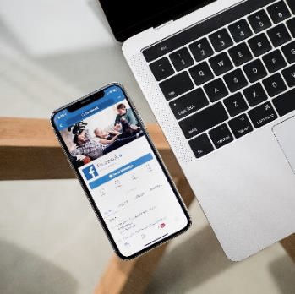
TV & RADIO
INTERNET & APPS
BILLBOARDS
PRODUCT PLACEMENT
Notes:
The Effect of Advertising on Spending
Experts estimate that the average person is exposed to anywhere between 250 and 5000 advertisements daily.
[click]
This takes into account not only the advertisements that we see when watching TV or listening to the radio,
[click]
but also those that pop up while surfing the internet and while using our favorite Apps on our phones;
[click]
glaring advertisements like billboards lining the highway,
[click]
to subtler advertisements such as product placements in movies and TV shows.

Slide 14
LOGO RECOGNITION
Activity
Notes:
Let’s test our own brand recognition skills by seeing if we can identify these logos. Use the chat feature to play along.
[click to show each one, discuss]
Nike
Kentucky Fried Chicken
Starbucks
Apple
Amazon
Chilli’s
McDonalds
Twitter
Target
I think you’d agree we all could names these logos with little hesitation.
Short of living in a cave and cutting of all communication from the outside world, what can we do to combat the influence of advertising?
The best way to combat the influence of advertising on our spending is to understand the tactics advertisers use to get us to buy.
NEXT SLIDE

Slide 15
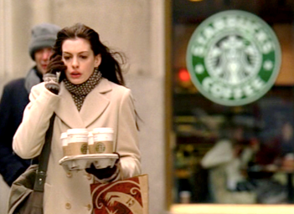
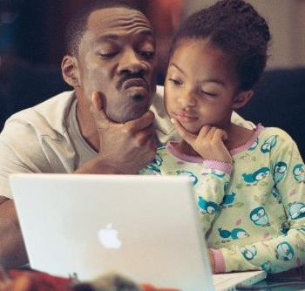
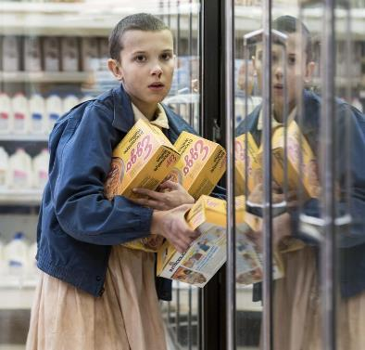
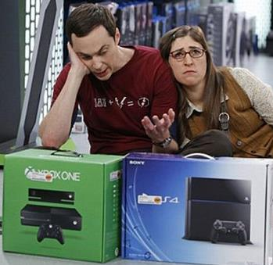
S
P
E
N
D
Notes:
[animation starts automatically]
Advertisers are constantly barraging us with images of happy, healthy, smiling people using their particular product. This creates a psychological connection in our brains, linking personal fulfillment with their product.
*take a moment to point out the specific products that are highlighted in the TV and Movie clips: Starbucks, Apple, Audi, Eggo, Xbox & Playstation.*
Advertisers will pay millions of dollars to have their product featured in in a scene. Example: Heineken Beer paid $45M to be centered in a movie scene. Apple doesn’t pay for product placement- instead, they send multiple ‘gifts’ to the production company with the hopes they may use the product in a scene… seems to work because Apple was the most promoted product in 2014.
[click]
These connections are so ingrained in our psyche and culture, we base an individual’s worth, including our own, on the stuff that we have.
NEXT SLIDE

Slide 16
SPENDING HABIT INFLUENCES
SOCIAL FACTORS
SELF CONCEPT
VALUES
ADVERTISING
Notes:
There are also social situations that can influence our purchasing behavior.
NEXT SLIDE

Slide 17
SOCIAL FACTORS
?
What are some social circumstances that might affect our spending?
Notes:
ASK: “What are some social circumstances that might affect our spending?” Please use the chat feature again to share some of your ideas.
Possible answers:
Neighbors
Family -
Friends
Society
Social class
Type of job
Point out : We are more likely to purchase items from people we know. For example, you are more likely to purchase something at a friend’s party than from someone you don’t know. That is why companies like Tupperware, Pampered Chef, Avon, Mary Kay, and many others, rely on in-home parties to sell their products.
Our social class has an influence on our spending attitudes as well. Have you ever experienced a time when you received a significant increase in income only to find that it increased your spending? This may be because of your change in social class. A social class is a group of people who have the same social, economic, or educational status in society. When you have more funds available you may be giving yourself permission to buy more or buy more expensive items.
If you are apposed to spending more money with your next raise, consider instead raising your contribution to your retirement for the amount you gained. Or set up a direct deposit to a savings account for that same amount. That way you still know you got a raise but your net income or your purchasing power is that same as before.
NEXT SLIDE

Slide 18
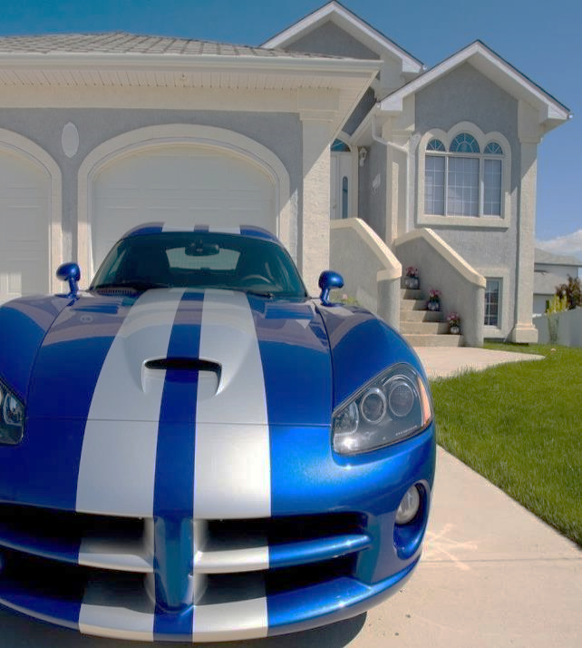
SOCIAL CLASS
PEER GROUP
PEER PRESSURE
The higher our socioeconomic status, the more luxuries we buy.
Spending more to ‘keep up’ with friends & peers.
Be aware, plan ahead.
Notes:
[click]
To some degree, consumers in the same social class exhibit similar purchasing behavior. The higher our socioeconomic status often the more expensive the cars, houses, clothing and food we buy.
[click]
Our peer group also has a strong influence on our spending habits. We may think that peer pressure of this kind only exists for teenagers, but it is true for adults too. Have you ever found yourself going out to lunch at work (even though you brought lunch) because everyone else was going out. Or spending more than you intended to when shopping with a friend.
[click]
Just by knowing that this peer pressure exists, we can still choose to spend but we can also choose not too. Sometimes it helps imaging yourself in the situation ahead of time. For example if you know you get asked out to lunch frequently at work but are committed to saving by prepping lunch ahead of time. Consider what you might say when you are asked “oh not today I’ve made my lunch thanks Susie” or “ I just ate lunch but I’d love to come for the company”
We hope in bringing this to our awareness that we can curb that pressure to spend.
NEXT SLIDE

Slide 19
2
4
3
1
5
Notes:
And let’s not forget about Atmosphere!
[click 1]
Most of us have had the experience of being in a department store or shopping mall and finding it extremely difficult to find the exit. This is not an accident!
[click 2]
The longer you are in the store the greater the likelihood that you will make a purchase.
[click 3]
Retailers control the lighting, layout, music, temperature and even smell, to entice you to buy.
[click 4]
For most people, shopping is not simply an act of purchasing what you need and then going home. Shopping is entertainment and social involvement and the shopping mall is “experiential.”
[click 5]
For researchers, malls are vast, complex and complete. Studies have shown that more actual purchases occur in the 3rd hour of shopping. So, malls are designed to keep a shopper there for at least that long, with winding architecture, appealing music, and even adding pleasing aromas its not difficult to do.
NEXT SLIDE

Slide 20
SPENDING HABIT INFLUENCES
SOCIAL FACTORS
SELF CONCEPT
VALUES
ADVERTISING
Notes:
Another very important factor that influences our spending is our self-concept.
NEXT SLIDE

Slide 21
I AM
Two of the most powerful words: what you put after them shapes your reality.
Notes:
Each of us carries a certain set of beliefs about ourselves. This set of beliefs is known as our self-concept. Generally speaking we act in ways that are consistent with our self-concept. For example, if a component of one’s self-concept includes “I am a good cook”, that person is more likely to offer to help in preparing food for a party than someone who has a self–concept of being a “bad cook”.
Read slide:
NEXT SLIDE

Slide 22
SPENDING HABITS
?
Think about your self-concept in regards to spending money.
Notes:
Your self-image answers the question “Who am I?” So self concepts may include ideas such as I am a hard worker, or good at math, or tall.
Now just think for a minute about your self concept in regards to spending money?
NEXT SLIDE

Slide 23
SELF-IMAGE
MENTAL STRESS
BEHAVIOR
COGNITIVE DISSONANCE
Notes:
[animation will start automatically]
Keep in mind that when our behavior doesn’t match our self image it leads to mental stress.
Acting in ways that are contrary to our self-image can lead to something called cognitive dissonance.
[click]
In psychology, cognitive dissonance is the mental stress caused when our brains are confronted with contradictory beliefs or values.
For example, a person whose self-image includes “I am good at riddles” will experience cognitive dissonance if they are confronted with a riddle that they cannot solve, while someone without that self-concept will likely not care.
If your beliefs don’t match your behavior you will be stressed out and let’s not forget about the idea of a self-fulfilling prophecy. A self-fulfilling prophecy is a prediction that directly or indirectly causes itself to become true.

Slide 24
SAVER
Feel stressed about large purchases.
SPENDER
More likely to make impulsive purchases.
S
Notes:
So what does this have to do with money?
Because we subconsciously go to great lengths to avoid cognitive dissonance, we will act in ways consistent with our self-concept around money.
[click]
If you think of yourself as a “Saver”, you will probably feel some psychological stress when you have to take money out of a savings account for a large purchase.
[click]
If you think of yourself as a “Spender” you may be more likely to make impulsive purchases.
Examining and recognizing your self-concept around money can help you avoid behavior that is counterproductive to reaching your financial goals. A ‘spender’ who makes a conscious effort to change their self-concept to that of a ‘saver’ will find it much easier to save for their goals.
Changing how you think about yourself may actually change your behavior. When faced with the decision of whether to buy or not to buy, if you think to yourself “I am the type of person who saves [click] money” you might actually find it easier not to buy.
NEXT SLIDE

Slide 25
SPENDING HABIT INFLUENCES
SOCIAL FACTORS
SELF CONCEPT
VALUES
ADVERTISING
Notes:
[animation automatically begins]
Once we have a greater understanding of our values and the factors that affect our attitudes about money, we can then decide if we need to make a change to reach our financial goals.
NEXT SLIDE

Slide 26
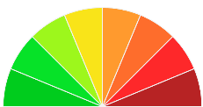
READY FOR A CHANGE
S
VALUES
PAY YOURSELF FIRST
LEARN TO LOVE SAVINGS
ALIGN WITH VALUES
Notes:
If you have determined changing and becoming more of a saver than a spender then it’s time to talk about a few strategies to save.
[click]
ASK: What does Pay yourself first mean? *allow for some responses*
Paying yourself first means to designate a certain amount for money before to go into savings before any other bills are paid. For example . . . If you decided that you will save 10% of your income then you would create your budget based on 90% of your take home pay. People report the most success when they have that 10% directly deposited into a savings account. If you don’t see it, you won’t miss it.
[click]
Another strategy is to Learn to love saving. You may find that watching your money grow and saving for future purchases will be more satisfying than spending impulsively. Remember we talked about this . . . change your self-concept from one of “I love spending” to “I love saving” can actually help you change your behavior.
[click]
Align your spending with your values. If you find that you are spending more money than you want on items like entertainment, eating out, clothes and other “wants” . . . review your core values. If “entertainment” was not one of your top values, why would you spend a lot of money on it? Find the things that truly matter to you and demonstrate it’s important with your spending decisions.
NEXT SLIDE

Slide 27
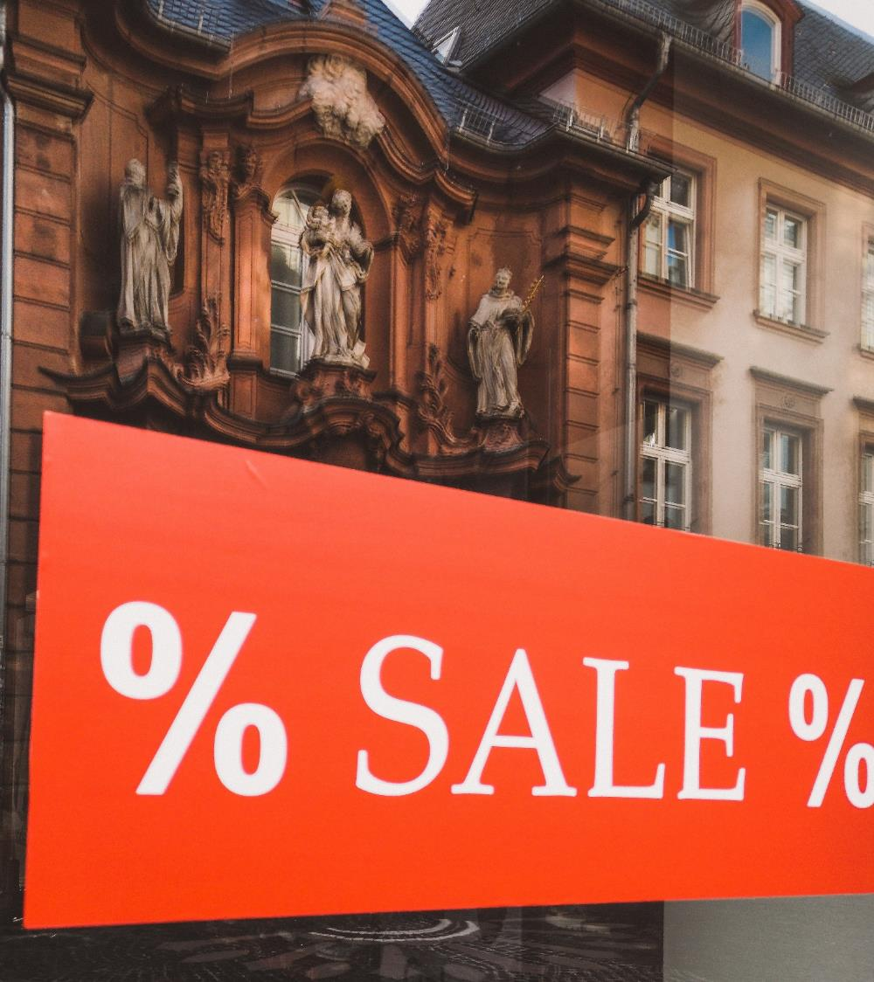
Will I use this?
Do I need this?
?
Where will I put it?
What if I wait?
Notes:
And finally please be aware that we are highly influenced by advertising. Think before you buy.
[click once, then automation begins] **Read questions off slide:**
All important questions to ask yourself before you buy to assure you are being intentional with your purchases.
What are some strategies that can help prevent those impulse purchases?
Discuss with Participants
DON’T LIST these too many =
Possible answers:
a. Why am I here?
b. Do I need this?
c. Will I really use this product?
d. Are there underlying motives for making this purchase?
e. Do I own anything else that provides the same use?
f. Did I feel a need for this item before I saw it in the mall?
g. Am I motivated to buy this because I like the setting I saw it in?
h. Did the salesperson influence my desire for this item?
i. Where will I put it?
j. What is the financial cost of this purchase and can I really afford it?
k. What if I wait?
l. What else will I have to give up to afford this?
m. What are the other costs of this purchase? (Will it start an argument with my spouse? Make me feel guilty? Do I need to buy other matching items?)
n. How do I feel?
NEXT SLIDE

Slide 28
VALUES
ATTITUDES
FINANCIAL GOALS
S
EMOTIONAL REACTIONS
NEW BEHAVIORS
Change Your Thinking, Change Your Behavior.
Notes:
**animations will start automatically**
Understanding your values, attitudes and emotional reactions can help you change your behaviors.
Defining your values helps you make money choices that are inline with them. Being aware of the things that impact your attitudes (social status, peer pressure and advertising) can help you change your behavior. And don’t forget building your savings usually relieves stress.
Combining this insight with why you buy will hopefully help you make the choices that will allow you to meet your financial goals.
NEXT SLIDE

Slide 29
GREENPATH FINANCIAL WELLNESS
is a nationwide non-profit that provides financial education and tools for people to lead financially healthy lives.
Notes:
I really hope this workshop has been helpful to lead you on the path to be intentional with your money choices.
Finally remember you’re welcome to schedule a free phone or in person assessment to meet with one of GreenPath’s financial wellness experts to review your credit report and receive tips tailored to your own situation.
*Provide GreenPath’s contact information.
Thanks everyone and have a great day!

